Slide 1

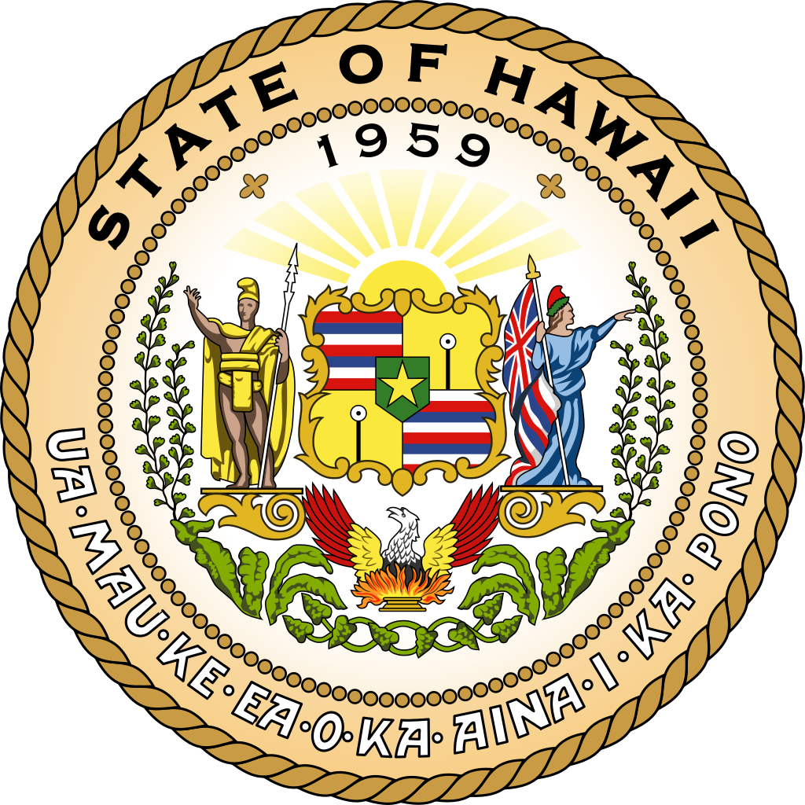


From Kingdom to State: The Fate of Hawaii Between Literary Image and Historical Reality
Prepared by: A. Gromov
MGIMO Student of MA Program International Security

Slide 2
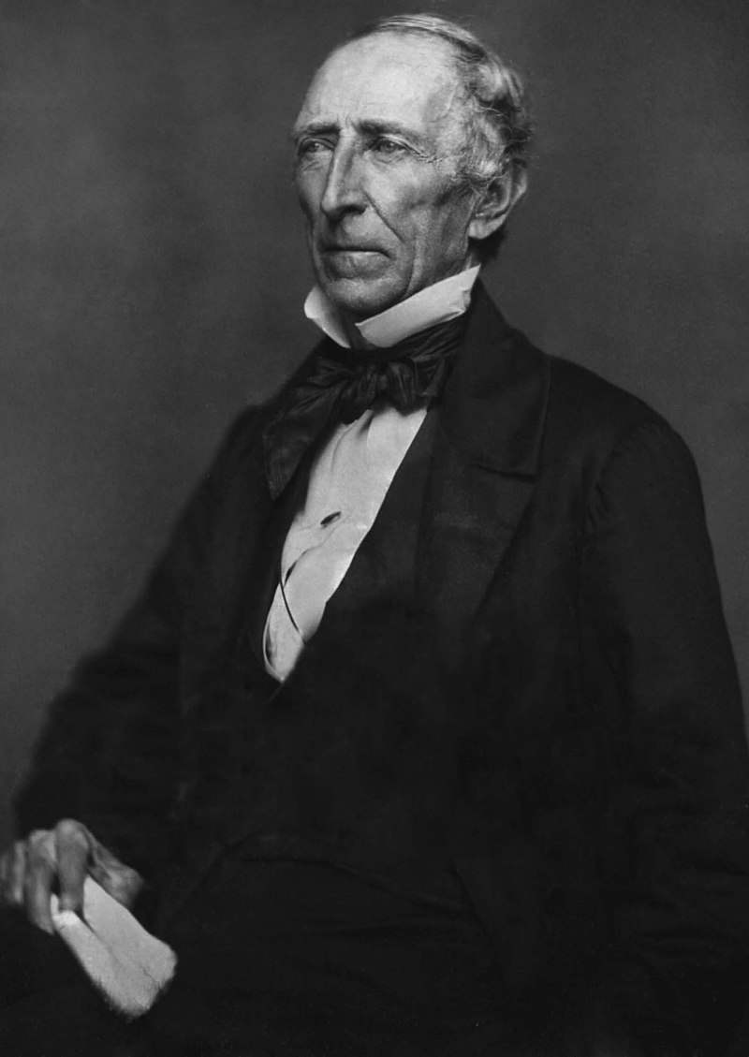
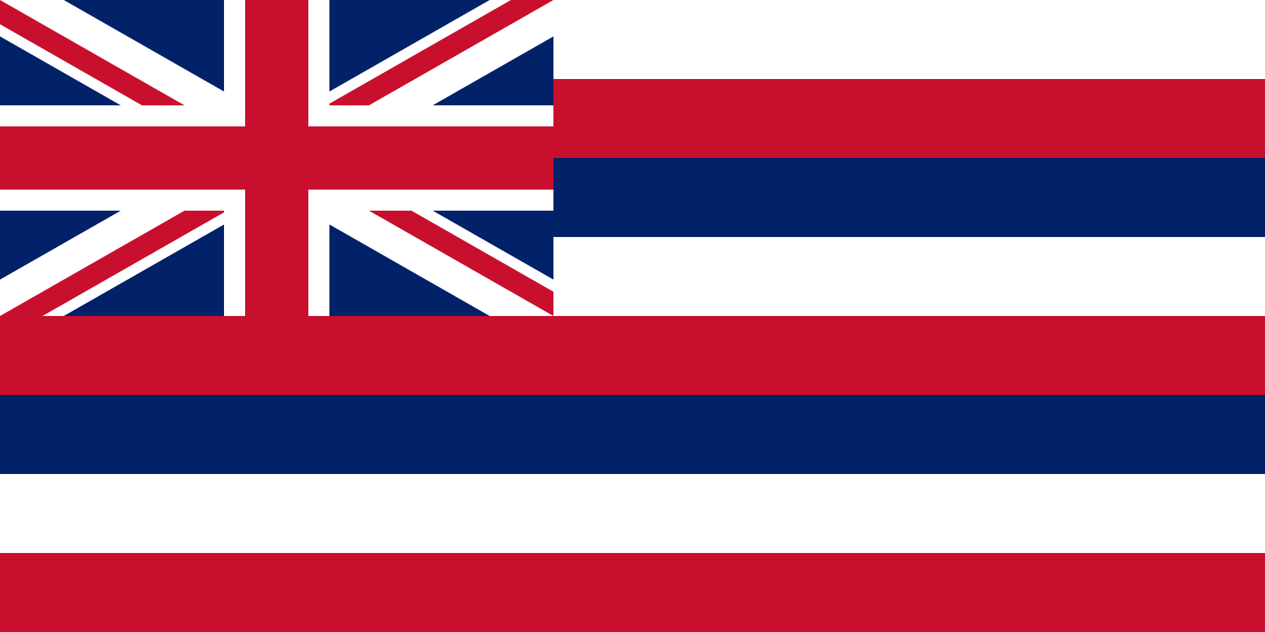
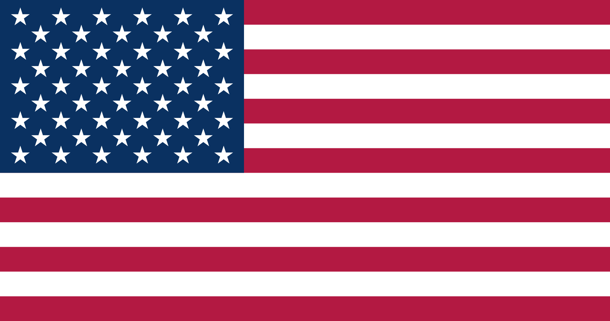
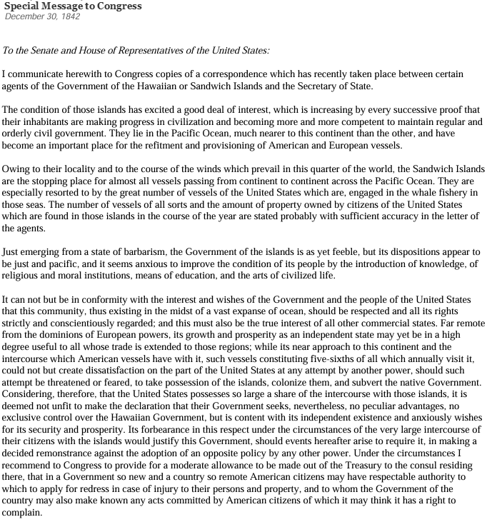
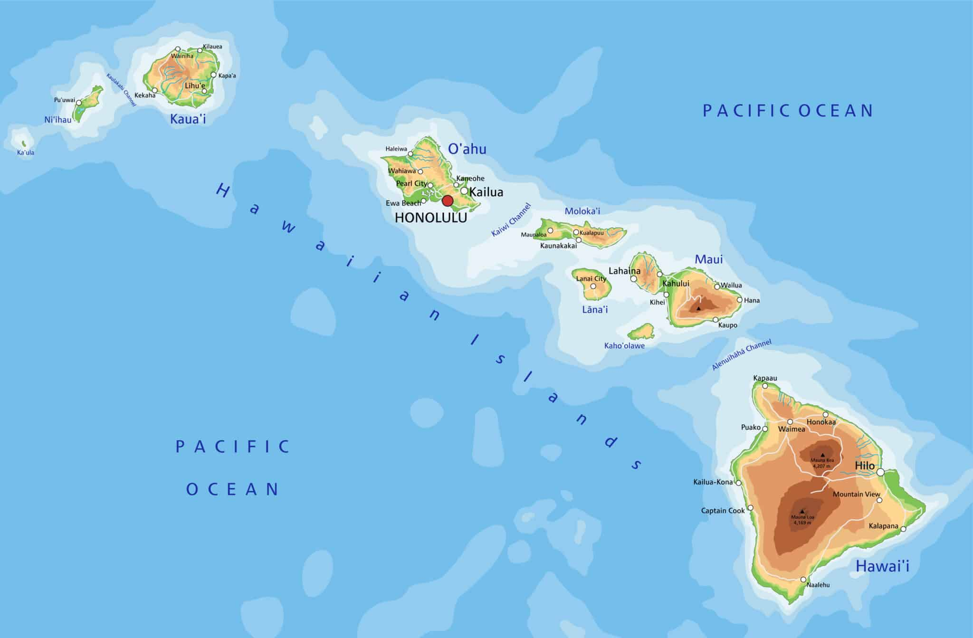
History of United States-Hawaii relations
Tyler Doctrine and Strategic Importance
Tyler Doctrine
Announced US intent to assert dominance over Hawaiian affairs.
Strategic Location
Pearl Harbor was an ideal naval base for power projection.
European Threat
Concern about European protectorates fueled US intervention urgency.
Tyler Doctrine
John Tyler
The 10th president of the United States
(1841 to 1845)
2

Slide 3
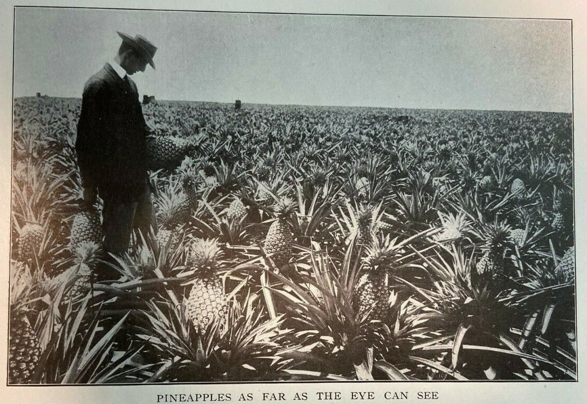
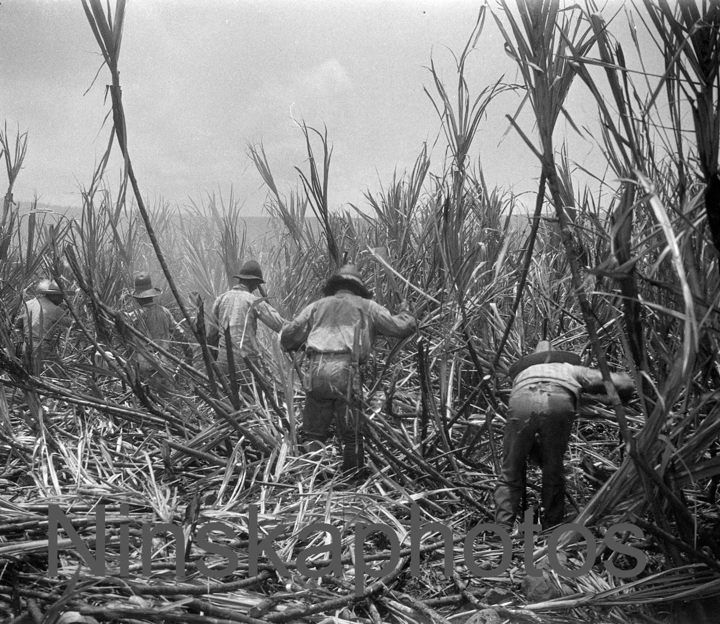
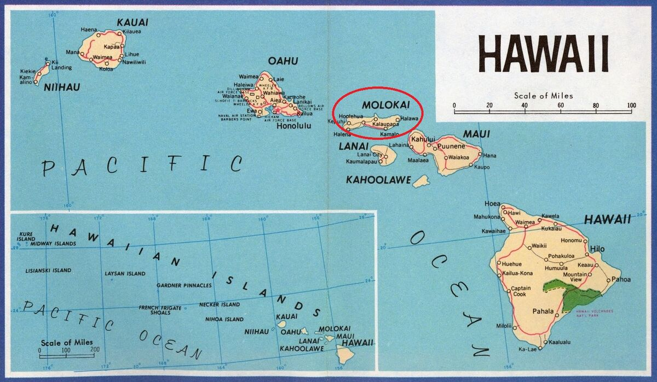
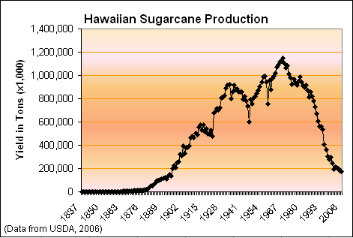
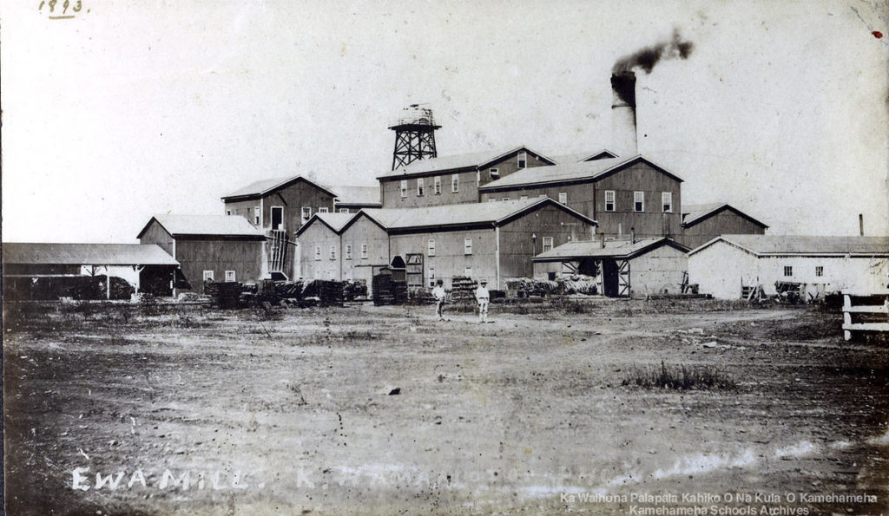
Unequal Treaties
American sugar plantations flourished, becoming Hawaii’s dominant economy.
Treaties of 1875 and 1884 favored US economic interests with trade benefits.
Plantations imported immigrant workers, changing island demographics.
Of course it was not in the economic interest of Hawaii.
3

Slide 4
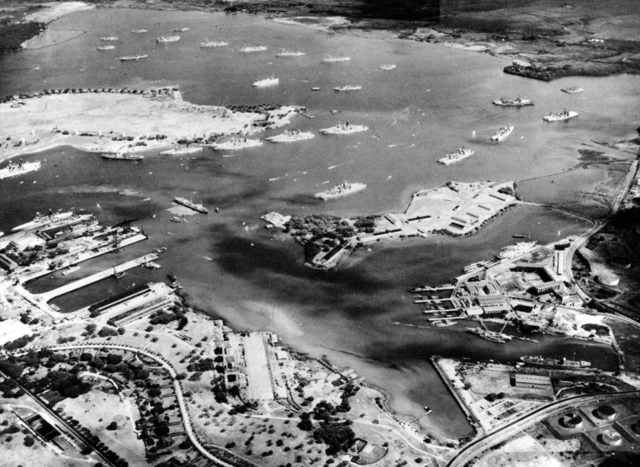
Increasing Pressure
US secured a lease for Pearl Harbor Bay, solidifying naval control.
This lease anchored American power in the islands.
Britain and France protested, but it was too late. However, they did not intervene later in the process.
Pearl Harbor Naval Base in 1940
4

Slide 5
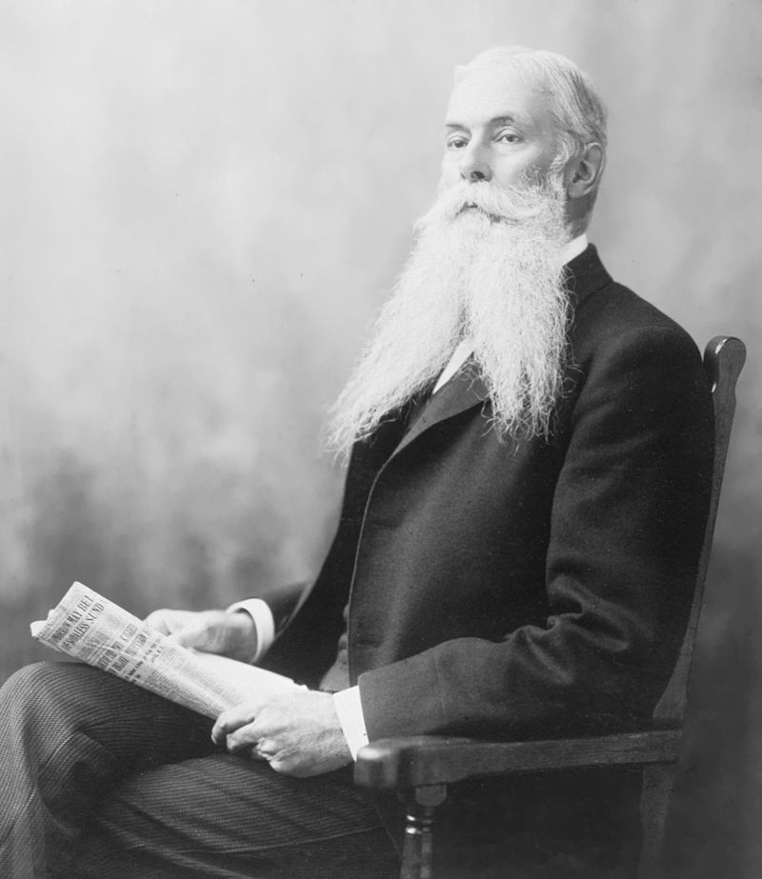
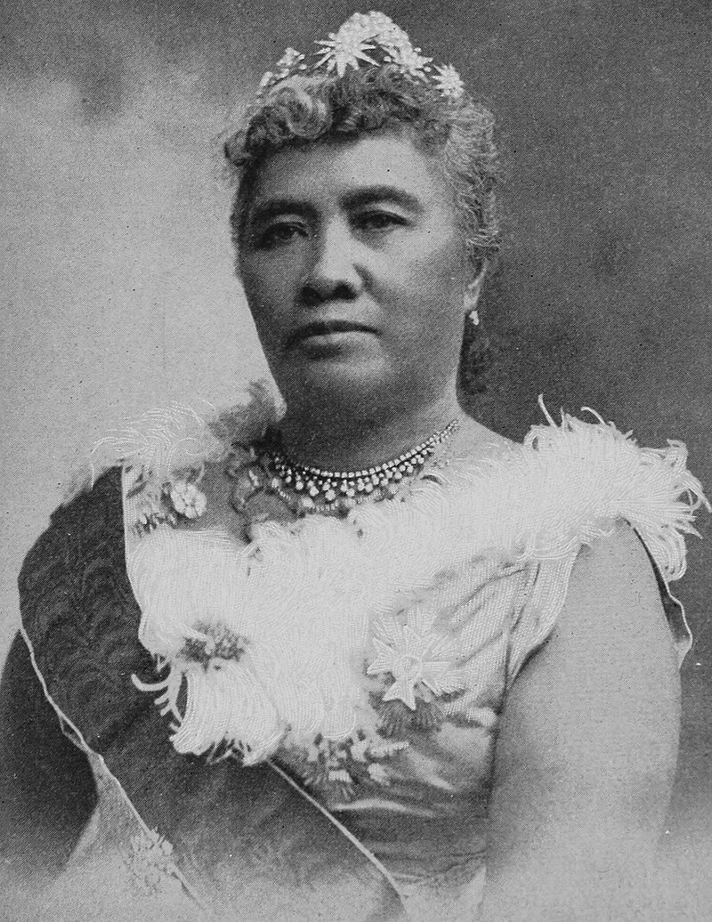
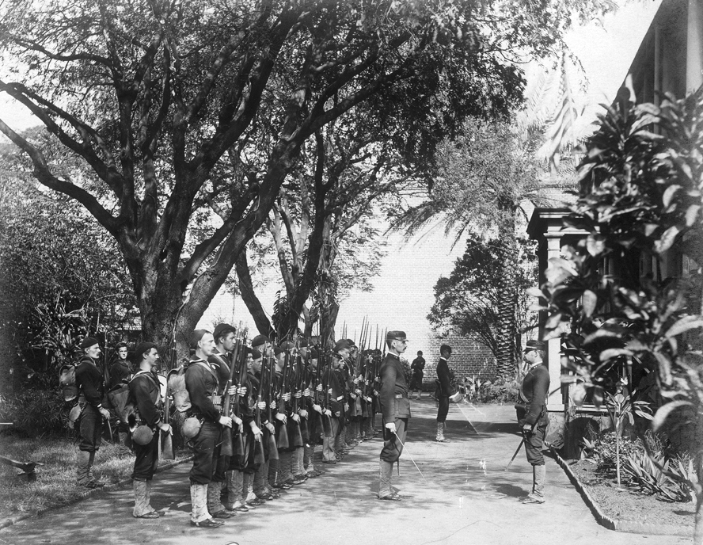
The Coup
Queen Liliuokalani sought to protect Hawaii's sovereignty and limit foreign power by advancing a draft of a new constitution, but it was not realized.
In 1893, American planters, backed by the US Navy, overthrew the monarchy.
After the coup, a puppet republic was established to facilitate annexation.
Sanford Ballard Dole
Hawaii-born lawyer and jurist
One of the key figures in the coup
1st President of Hawaii and later 1st Territorial Governor of Hawaii
Queen Liliʻuokalani
Last sovereign monarch of the Hawaiian Kingdom
The USS Boston's landing force on duty in Honolulu during coup days
5

Slide 6
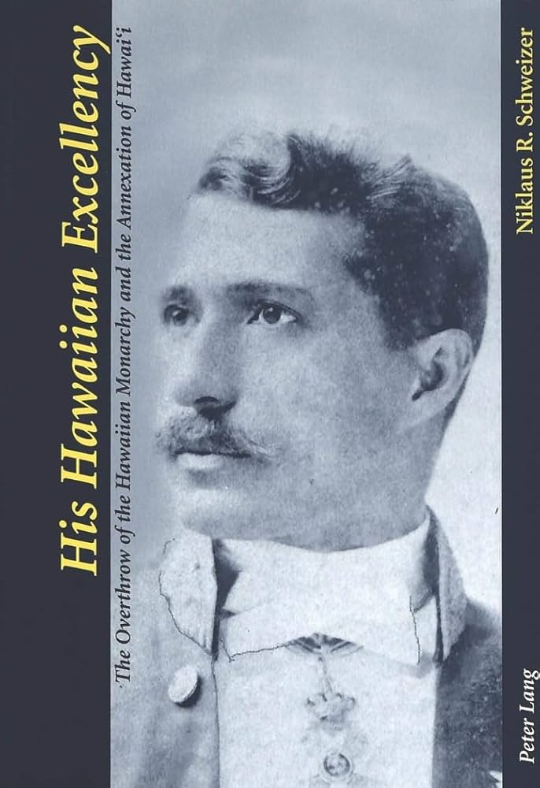
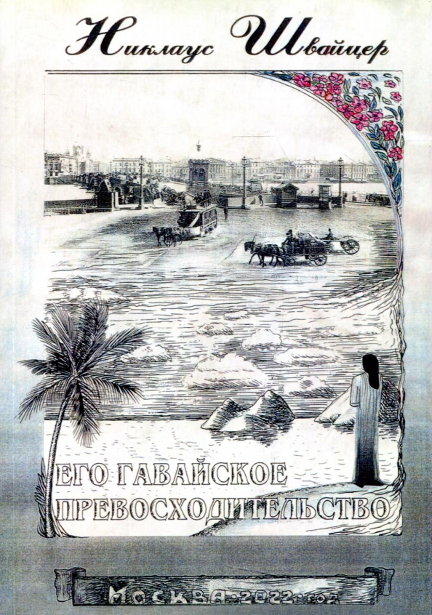
“His Hawaiian Excellency”
Deep Study
Reconstruction of Historical Context
Understanding Motivations
Immersive Experience
Comprehensive Perspective
Respectful Approach
On the cover: CURTIS P. IAUKEA – army officer, prominent statesman and diplomat in the Kingdom of Hawaii and later the Provisional Government of Hawaii and the Territory of Hawaii as part of the USA.
One of the main characters in the book.
6

Slide 7
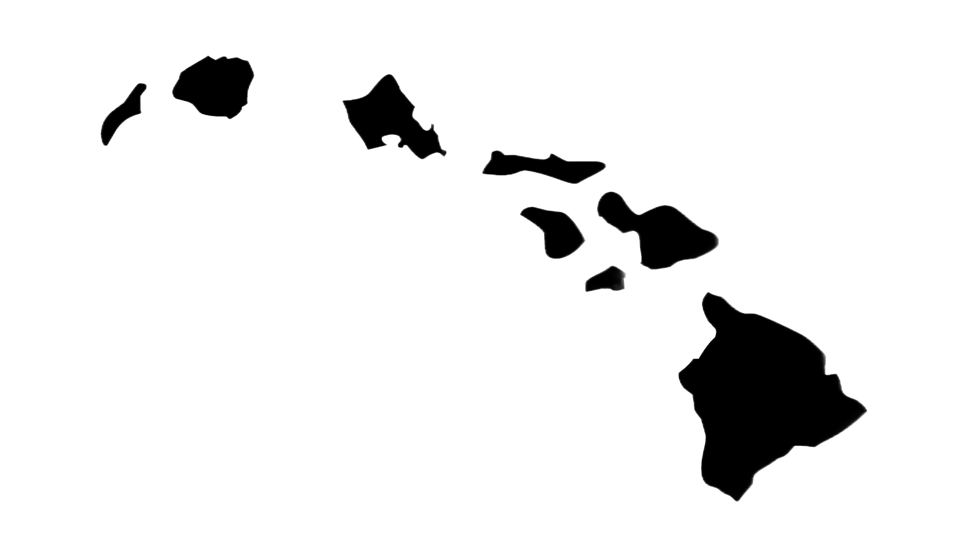
Expressing my gratitude for your attention!

